Slide 1
Boston crime data analysis

Slide 2
The Boston Police Department is planning to open a new police station. In order to select the best location I'll use FourSquare so that the most suitable place is visible. The station should be in the place where most of crimes are committed and there's no police station nearby.

Slide 3
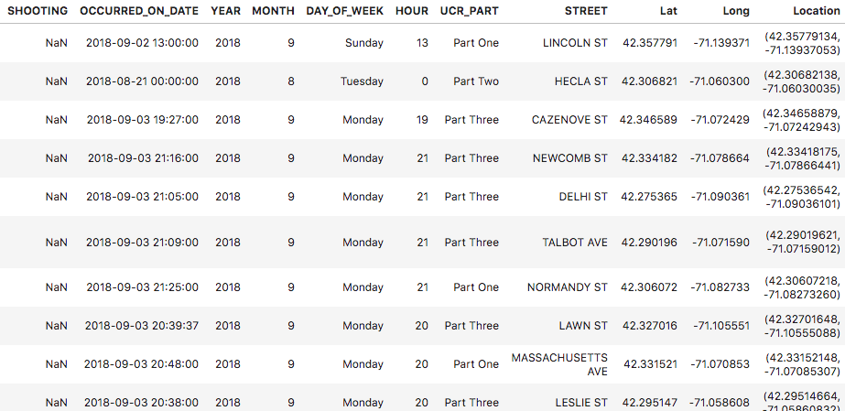
The Boston Crime data from open source https://www.kaggle.com/AnalyzeBoston/crimes-in-boston is used combining with the Foursquare location data. Dataset contains such characteristics of crimes as type, location, year, offence type
I cleaned the data dropping missing values so that it doesn’t affect the results. Only first 500 crimes were used as the dataset is too large itself.

Slide 4
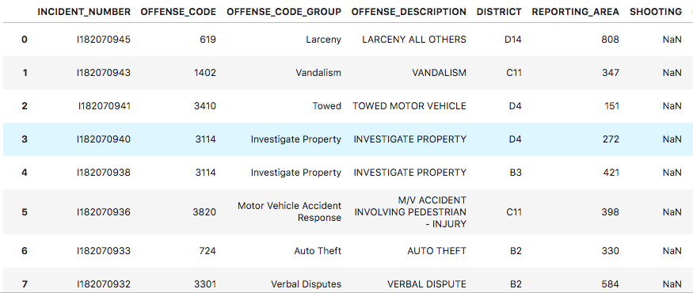

Slide 5
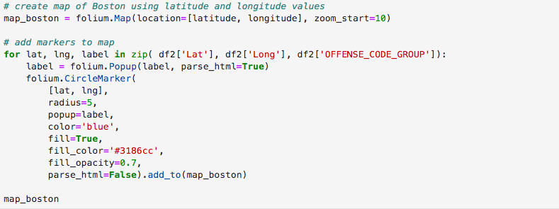
donec quis nunc
Folium library is used to demonstrate everything on map. Crimes’ latitude and longitude were taken.

Slide 6
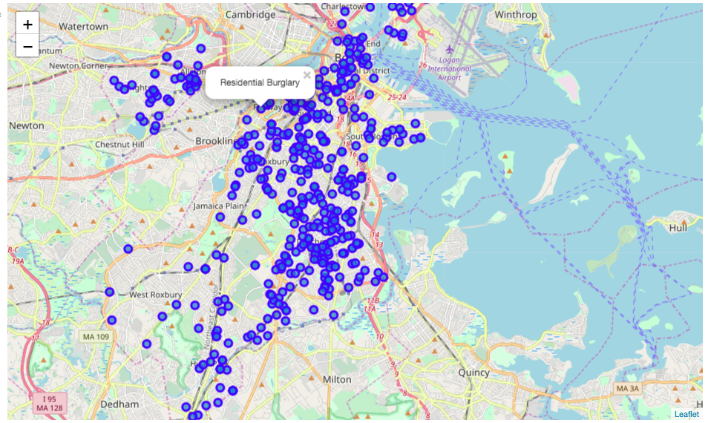

Slide 7
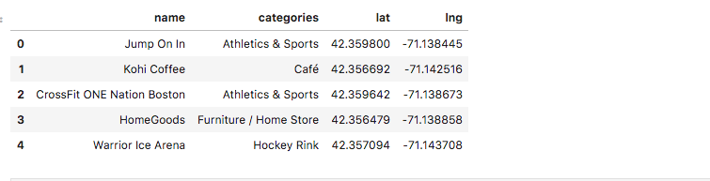
Foursquare API was used as well. With it we could see nearby venues which are in 500 meters from crime happened. We can use this data for the sake of security of these venues.

